Slide 1
Title I Annual Parent Meeting
The Boca Ciega High School
10/18/21
5 p.m.
Media Center
Jennifer Gil

Slide 2
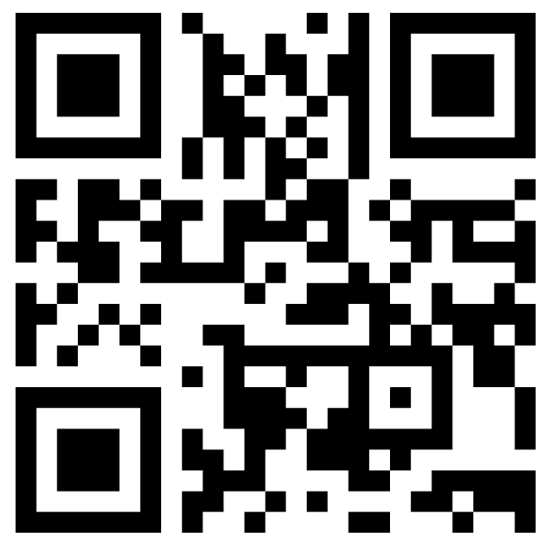
What makes for a great education?
Voting Code: 7524 0860
https://www.menti.com/esjenaxzsf
Notes:
Insert icebreaker get to know you activity here!
7524 0860

Slide 3
About Title I
Title I is the largest federal assistance program for our nation’s schools.
The goal of Title I is to address the academic needs of students and to assist them in meeting their state’s academic standards.
The program serves 75 schools in Pinellas County including eligible students in 34 non-public schools.

Slide 4
Title I Funding
Pinellas County Schools
Increased Student Achievement
Federal Government
1
3
The Florida Department of Education receives funds from the federal government. Districts receive Title I funds from Department of Education, and the school district distributes these funds to schools based on the percentage of children eligible for free/reduced price lunch; however, students do not have to be from low-income families to receive help.
2
4
Florida Department of Education
The Boca Ciega High School
Notes:
The Florida Department of Education receives funds from the federal government. Districts receive Title I funds from Department of Education, and the school district distributes these funds to schools based on the percentage of children eligible for free/reduced price lunch; however, students do not have to be from low-income families to receive help.

Slide 5
Supplemental
Definition: provided in addition to what is already present or available to complete or enhance it.
https://languages.oup.com/
Notes:
Title I is supplemental federal funding that provides extra academic support and learning opportunities.

Slide 6
Title I Programs Provide Supplemental Support
Supplemental Resource | Positive Impact
Additional supplemental personnel | Full-time College & Career Counselor Two MTSS Coaches
Additional training opportunities for school staff | Paid collaborative planning for Pre-AP implementation and core content areas.
Parent and Family Engagement Resources and Training Workshops | Paid extra hour for volunteer coordinator.
Supplemental teaching materials, equipment, and technology | Literacy materials, laptop covers and supplies.
Notes:
Use additional slides if necessary. This is where you want to really highlight Title I funding and how it positively impacts your scholars! Additional supplemental personnel (add specific positions)

Slide 7
Title I Schoolwide Planning
First
Second
Last
Input from school, family, and community members determine how Title I funds are used based on a needs assessment.
Please attend online or in-person meetings/trainings and complete surveys to provide input on Title I funding.
All Title I schools must document that parents are involved in the schoolwide planning process.

Slide 8
Title I Schoolwide Budget
Boca Ciega High School is provided $236,899 to pay for supplemental resources and programs for increased student achievement. The Title 1 Parent Involvement budget is $5,078.
We use our Title I funds to pay for the following:​
Three full time student support positions (one counselor and two MTSS coaches)​
Additional hour per day for our part time Volunteer Coordinator​
Parents can be involved with our Title I Budget decisions through our School Advisory Counsel (SAC)​.

Slide 9
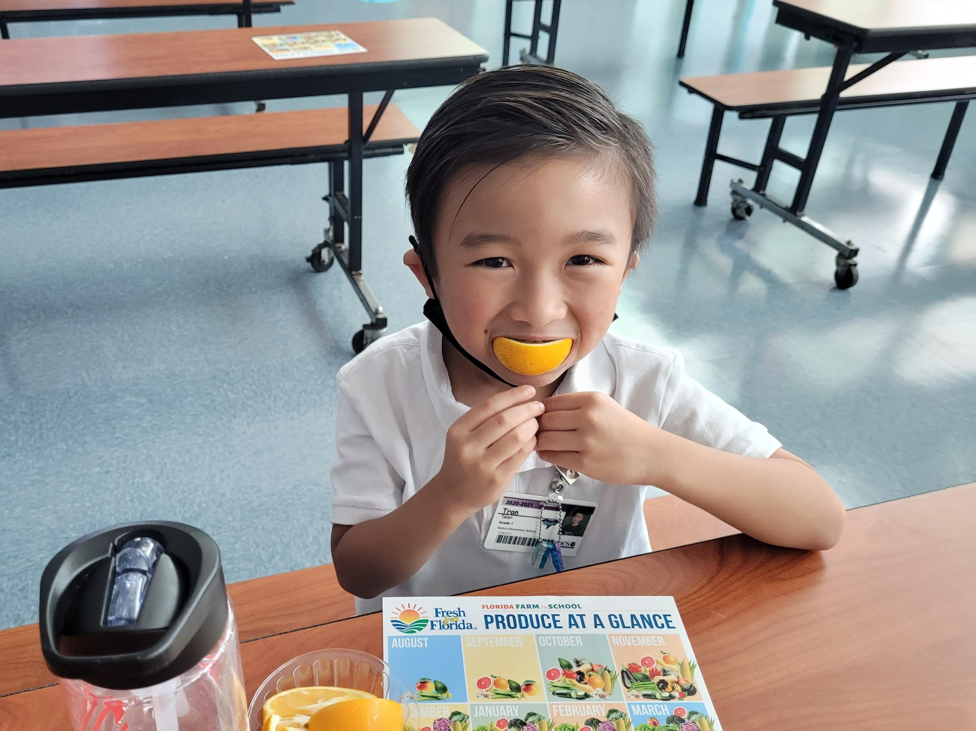
Parent’s Right to Know
As a parent of a student attending a Pinellas County School Public School, you have the right to…
Be provided information on your child’s level of achievement on assessments in Reading/Language Arts, Writing, Mathematics, and Science.
Request and receive information on the qualifications of your child’s teacher and supplemental personnel working with your child.
Be notified of non-highly qualified or out-of-field teachers at the school.
Be informed if your child is taught by a non-highly qualified teacher for four or more consecutive weeks.

Slide 10
Working Together for Student Success
As a Title I parent you have the right to be involved in the development of the following plans and documents for our school which can be found on our website (insert website) to view as well as in the Parent Station located in the Volunteer Coordinator’s Office.
School Improvement Plan (SIP)
Title I Schoolwide Plan
You will find a copy of our School Improvement Plan, Title I Schoolwide Plan, School’s PFEP, the School District’s PFEP, Parent’s Right to Know Memo, Upcoming Events, Compact,
Parent and Family Engagement Plan (PFEP)
School-Parent-Student Compact
Notes:
Our school’s Title I Parent Station is located (insert location or photo of Title I Parent Station (front office and on the webpage)
You will find a copy of our School Improvement Plan, Title I Schoolwide Plan, School’s PFEP, the School District’s PFEP, Parent’s Right to Know Memo, Upcoming Events, Compact, (insert other documents at your station)

Slide 11
Parent-School-Student Compact
The purpose of the compact is to foster student achievement. By signing the Parent-School-Student Compact, (Insert name of school here), teachers, staff, parents and students agree to work together to share the responsibility of helping students meet or exceed state, district and school academic goals.
The Parent-School-Student Compact is updated every year to include parent, student, teacher, and staff input. Parent, student, teacher and staff comments are welcome at any time during the year.
Please review and sign your child’s Compact.
Our goal is to receive 100% participation!

Slide 12
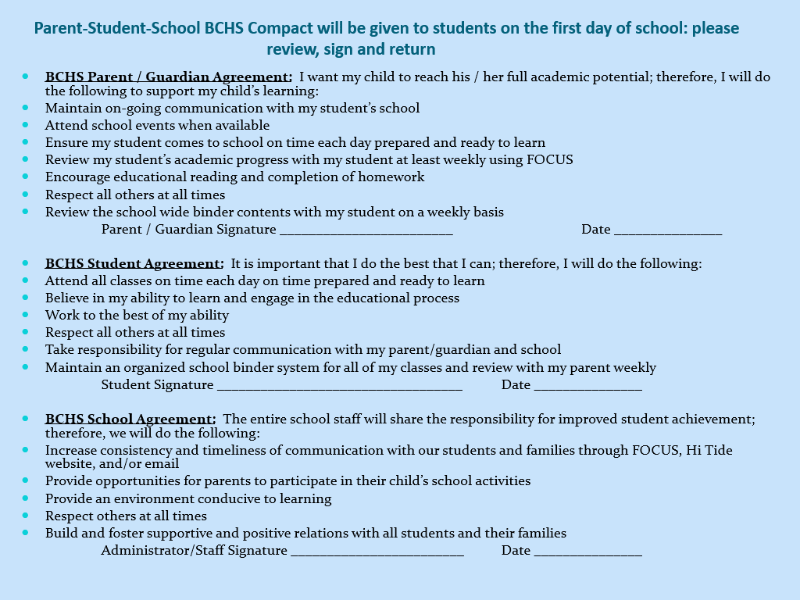

Slide 13
Parent and Family Engagement Plan (PFEP)
The PFEP Sections include information about the following:
Parent trainings to increase student achievement
Staff trainings for engaging parents
Communication methods between home and school
Flexible meeting times
Accessibility for parents
Coordinating with other Federal Programs
Notes:
Provide information on the specific committees that parents can be involved. Include the purpose, date and time of meetings.
Explain the PFEP and its purpose.

Slide 14
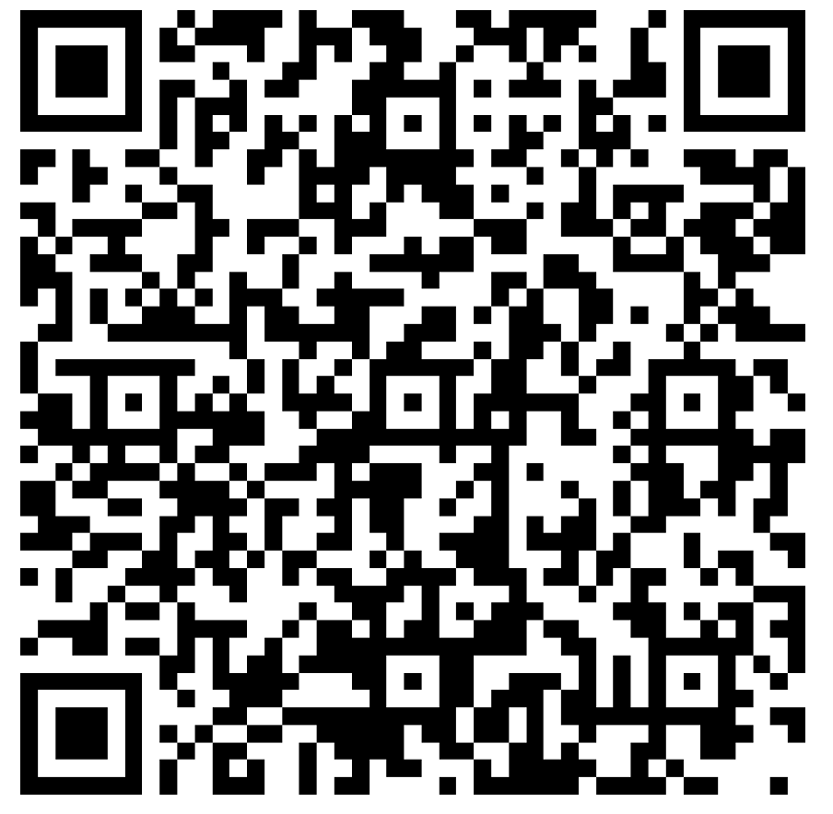
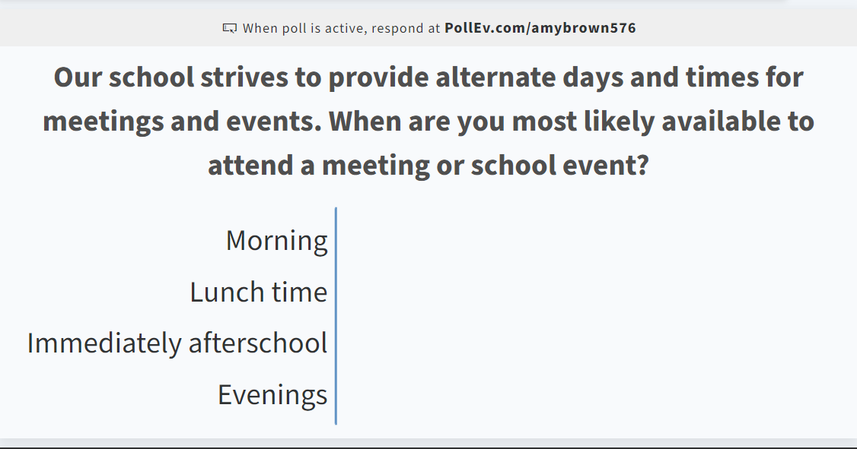
Opportunity for Two Way Communication
As mentioned in the previous slide, the PFEP ensures to provide families with flexible meeting times.
What times of day work best for you to attend a parent meeting?

Slide 15
We want YOU!
Parent Advisory Council (PAC)

Slide 16
Parent Advisory Council (PAC)
The District has a Parent and Family Engagement Plan. The summary of the this plan is in the Title I School & Family Partnership Overview.
You may access the full plan at www.pcsb.org/titleone
The Parent Advisory Council (PAC) is responsible for reviewing and revising the District PFEP.
PAC will meet virtually or in-person with the district’s Title I Family Education Coordinator.
PAC meets twice a year, if you are interested in representing our school please notify, Amy Brown at brownamyl@pcsb.org
Notes:
Please add your PAC representative in slide and email Amy Brown the contact at brownamyl@pcsb.org

Slide 17
BCHS Report Card
Accountability Measure | 2017-2018 | 2018-2019 | 2020-2021
ELA Ach. | 45 | 42 | 33
ELA Gains | 48 | 46 | 38
ELA L25 Gains | 36 | 44 | 34
Math Ach. | 36 | 32 | 24
Math Gains | 42 | 38 | 22
Math L25 Gains | 33 | 41 | 26
S.S. Ach. | 58 | 52 | 42
Sci. Ach. | 68 | 66 | 63
Graduation | 53 | 57 | 98
CCR | 91 | 92 | 61
% of total points earned | 51% or 510/1000 | 51% or 510/100 | 44% or 441/1000
Overall School Grade | C | C | C

Slide 18
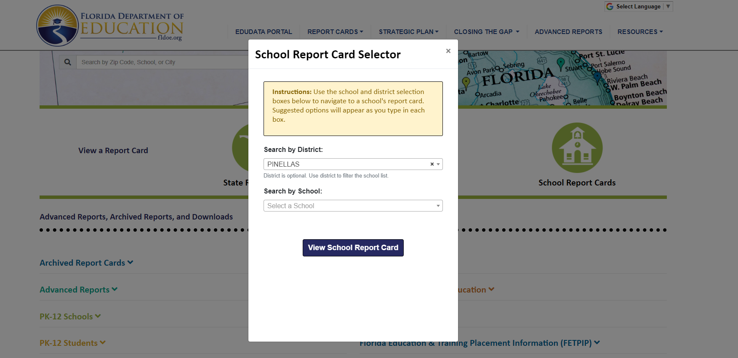
Visit to find district and school grades, EduData Portal
Notes:
When you follow the link EduDataPortal select Pinellas County and search by school.

Slide 19
Florida Standards
Florida’s academic content standards establish high expectations for all students.
Florida Standards identify what your child needs to know and be able to do in all content areas. You may read more information by visiting fldoe.org/academic/standards/.
Also, your child’s teacher will be able to explain the standards for your child’s grade level.
Notes:
All curriculum, instruction and assessments are based on student-centered expectations.

Slide 20
Florida Standards Assessment (FSA)
Spring FSA ELA 9th & 10th Grade
Writing, 4/4-4/15
Reading, 5/2-5/27
Fall FSA Retakes:
Writing/Reading, 9/13-10/1
Alg. 1 EOC, 12/1 & 12/2
Spring Retakes:
Writing/Reading, 2/21-3/11
Alg. 1 EOC, 2/21-3/11

Slide 21
Florida End of Course (EOC) Assessments (Algebra 1, Biology, Civics, U.S. History, Geometry)
Testing window for all EOCs
May 2nd – May 27th
To learn more about state assessments visit the Florida Department of Education’s website, fldoe.org/accountability/assessments.

Slide 22
Florida Benchmark For Excellent Student Thinking Standards (B.E.S.T). You may read more information by visiting, http://www.fldoe.org/standardsreview/
Notes:
All curriculum, instruction and assessments are based on student-centered expectations.

Slide 23
Notes:
Here is the timeline for the implementation for Florida’s BEST Standards.

Slide 24
Working Together for Student Success
Please join us…For monthly SAC meetings
January 24, 2022
February 21, 2022
April 18, 2022
May 16, 2022

Slide 25
Next Steps
We encourage you to…
Review the Compact throughout the year as it relates to your child(ren)’s goals
Communicate with the teachers and other staff
regularly
Participate in giving your input for our SIP, PFEP, and Compact

Slide 26
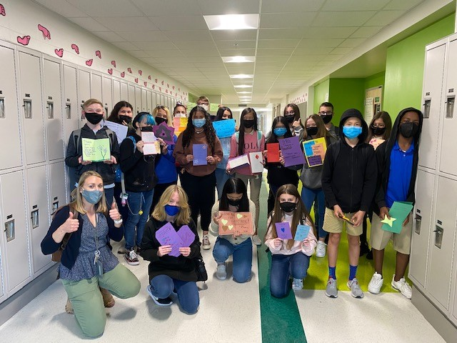
Additional Resources
Title I Parent & Family Coordinator – Amy Brown
brownamyl@pcsb.org
Learning at Home Family Resources - https://www.pcsb.org/Page/32836
Volunteer in a Pinellas County School - https://www.pcsb.org/Page/459
Parent Advocacy – Keosha Simmons simmonskeo@pcsb.org
Parent Academy POWER HOURS Webinars - https://www.pcsb.org/Page/26534
Partnerships - https://www.pcsb.org/Page/418

Slide 27
We appreciate your time!
Please feel free to ask any questions and provide feedback on our Title I Program.

Slide 28
Contact Us
924 58th St. South
Gulfport, FL, 33707
727-893-2780
Gilje@pcsb.org

Slide 29
Education is for improving the lives of others and for leaving your community and world better than you found it.
Marian Wright Edelman

